Slide 1
HTML
Դաս։ 06 Position, Z-index, Overflow

Slide 2
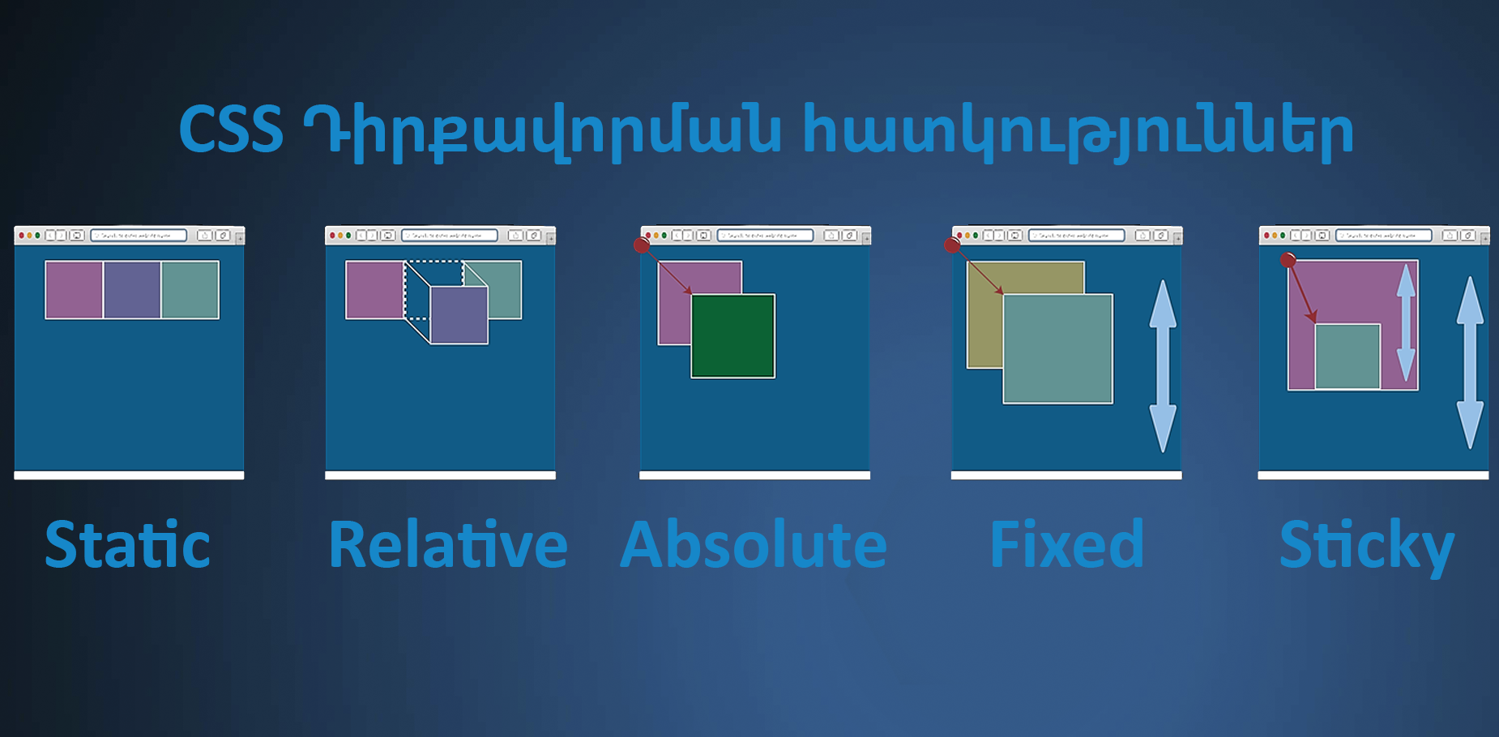
Positions

Slide 3
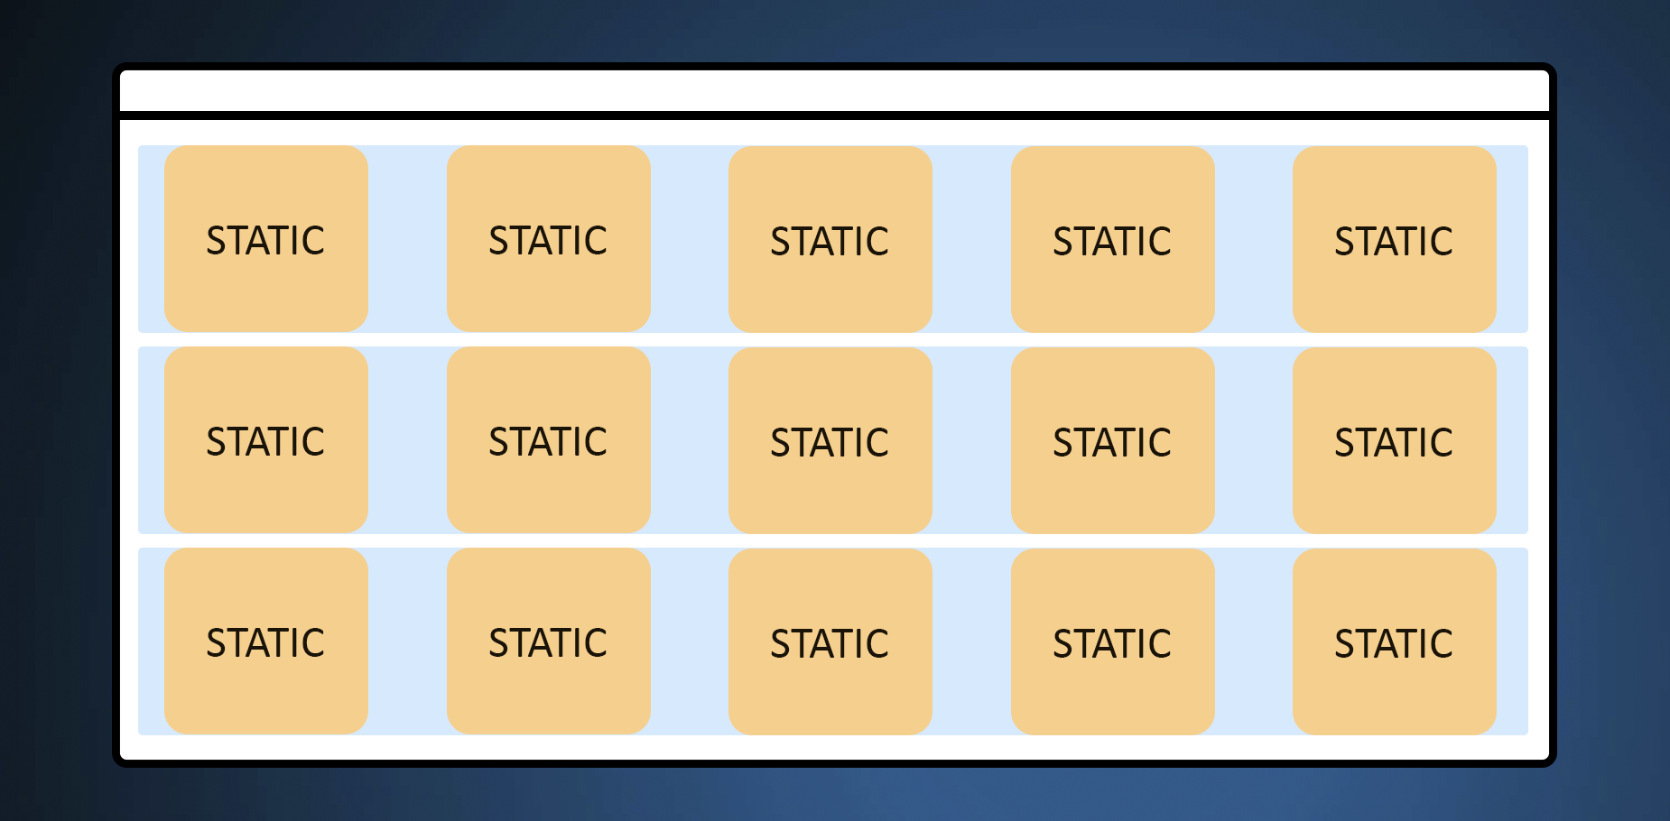
Position Static

Slide 4
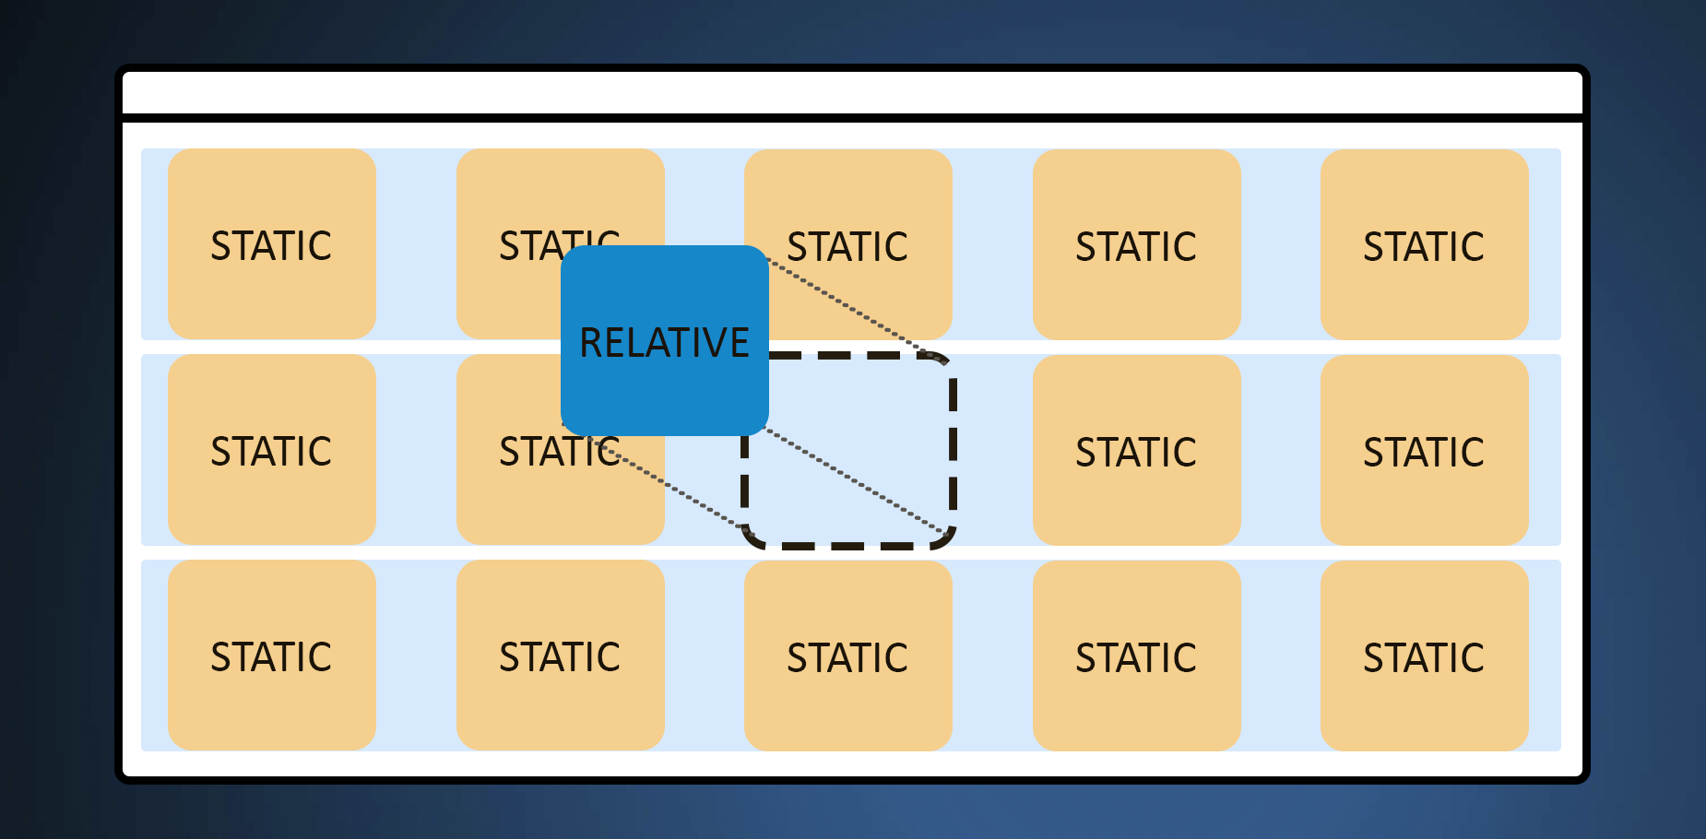
Position Relative

Slide 5
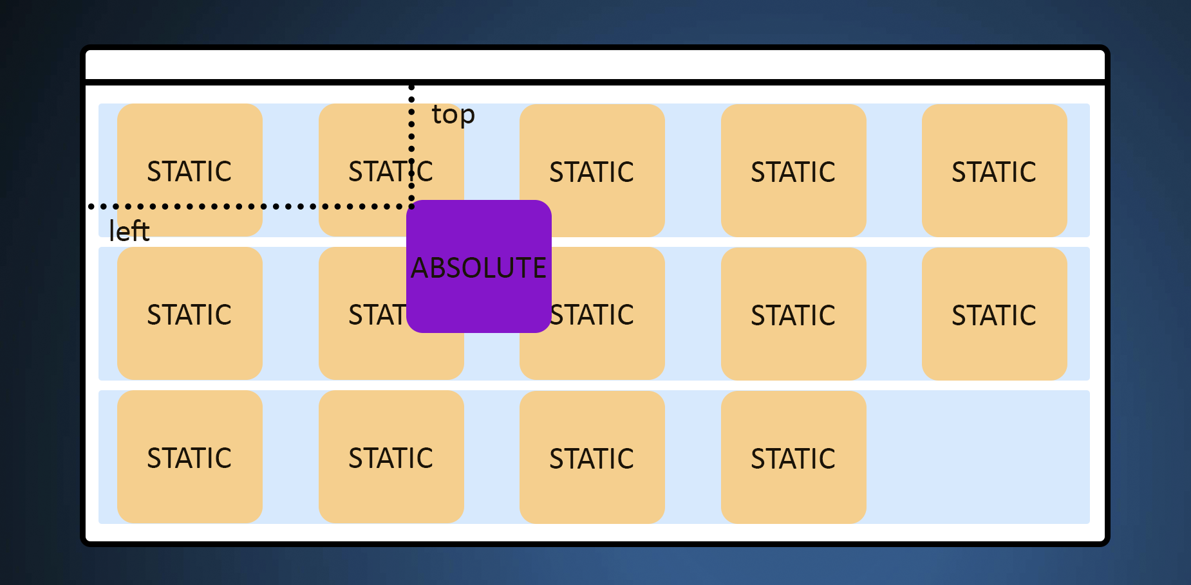
Position Absolute, Fied, Sticky

Slide 6
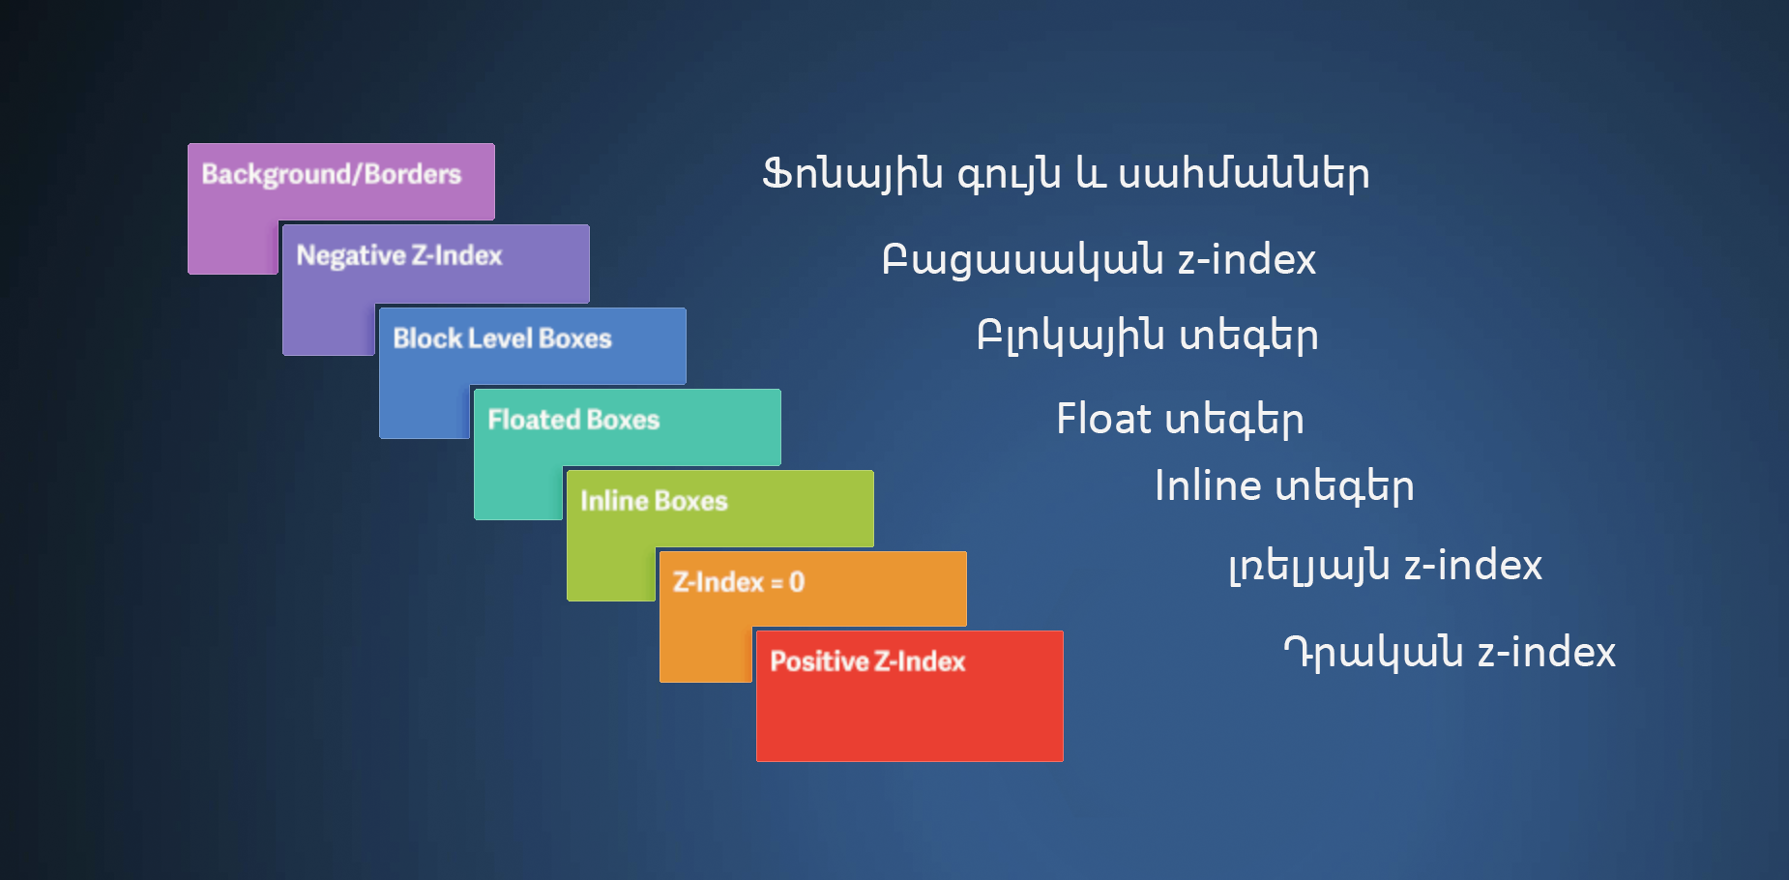
Z-index

Slide 7
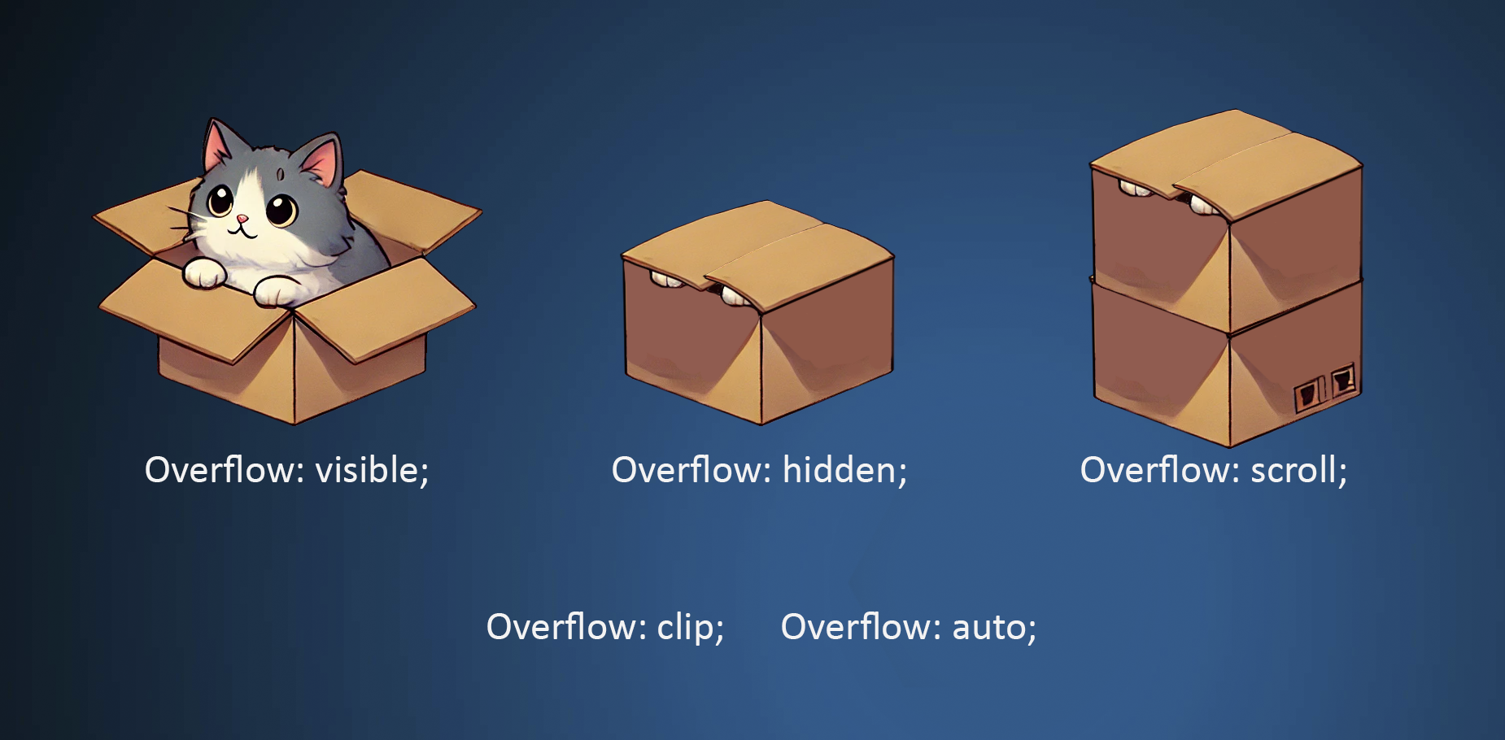
Overflow

Slide 8

Visibility

Slide 9
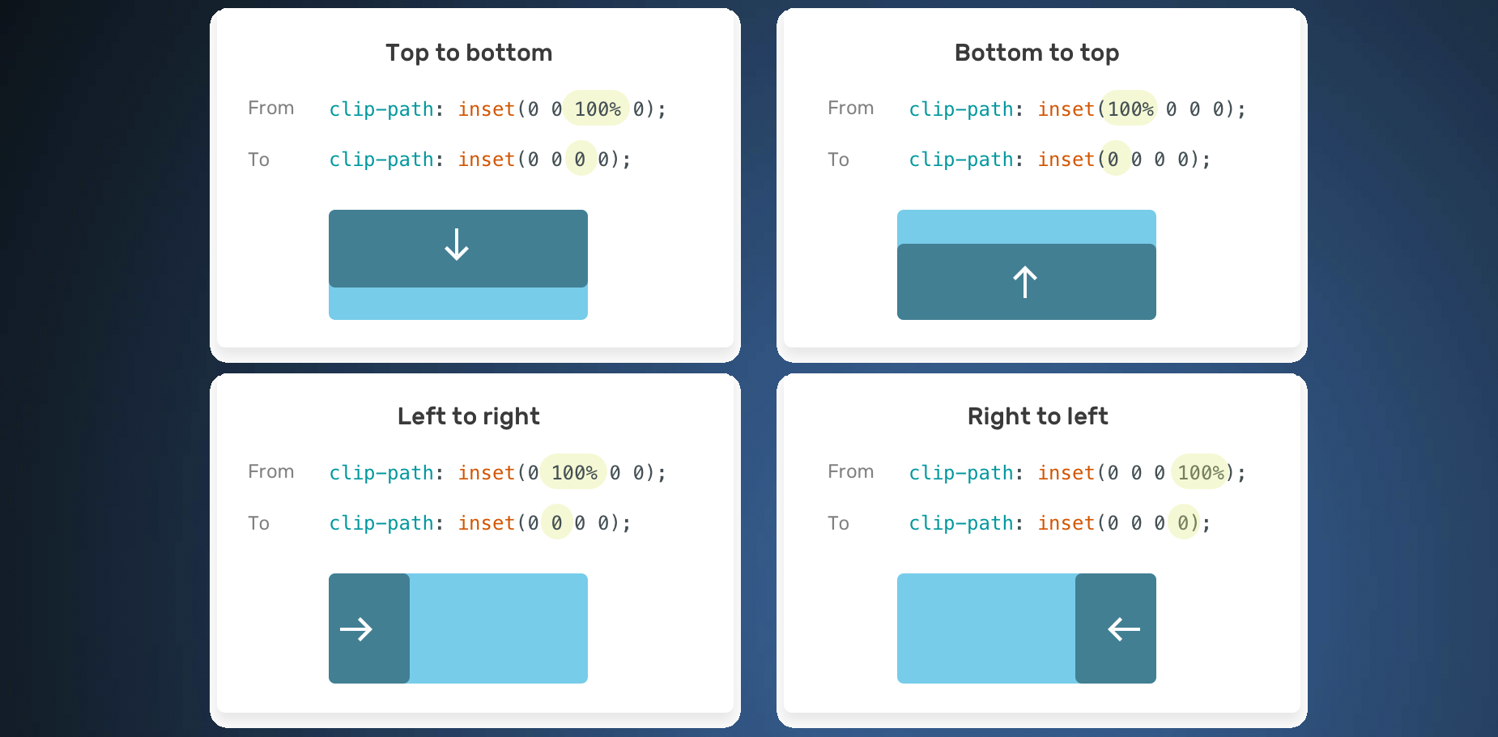
Clip-path

